Slide 1


Power Query Table Functions Part 4

Slide 2
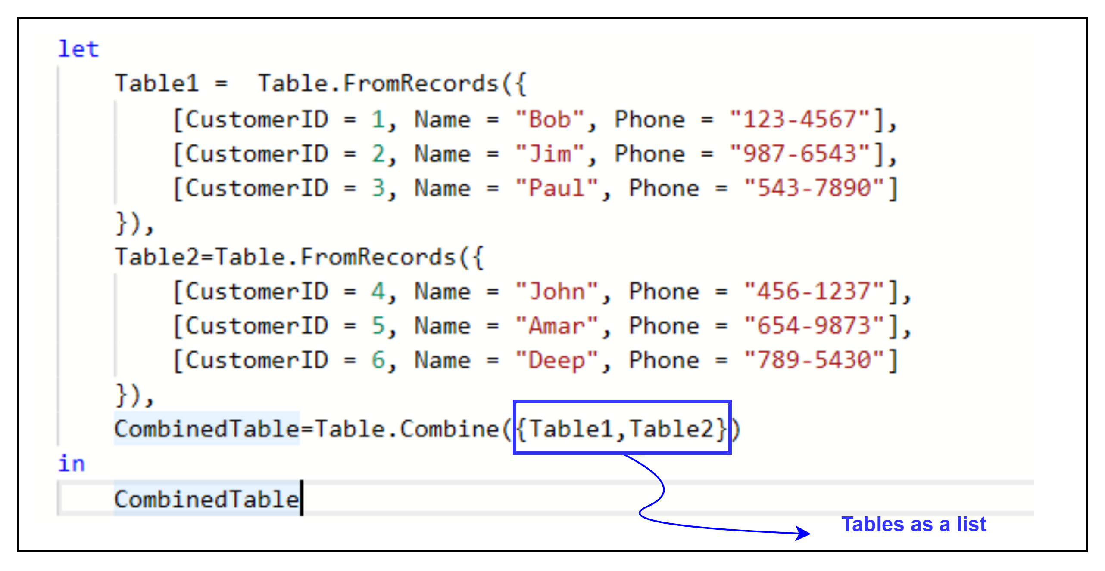
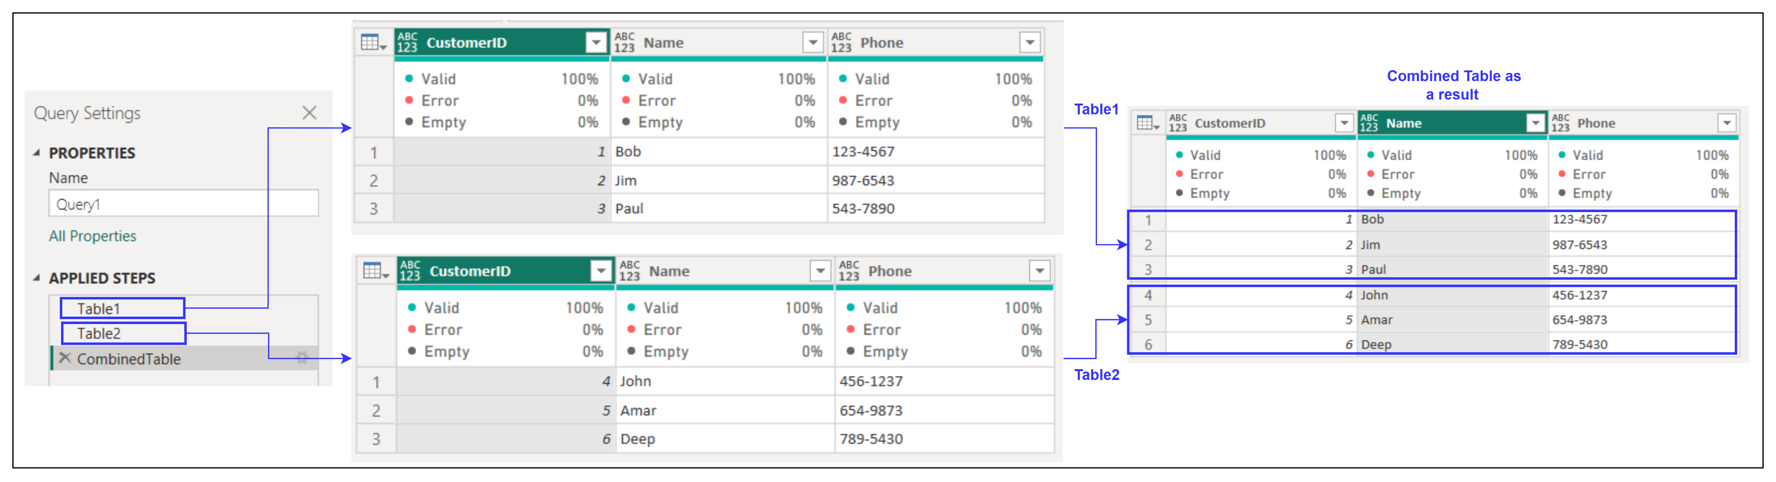
1. Table.Combine
Description: Combines a list of tables into one single table.
Example:
Result:
Use Cases:
Appending multiple tables with the same schema.
Consolidating data from different sources.

Slide 3
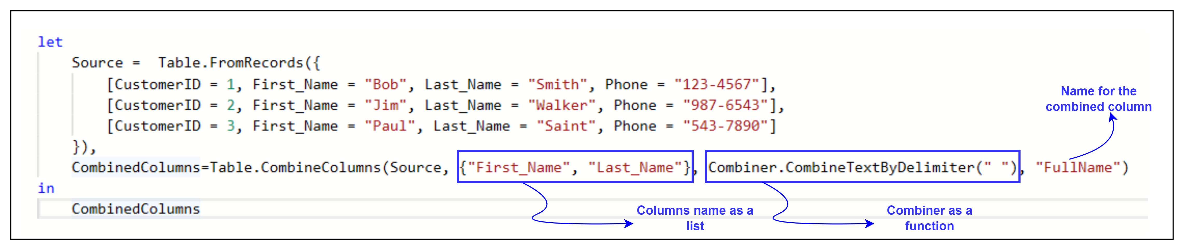
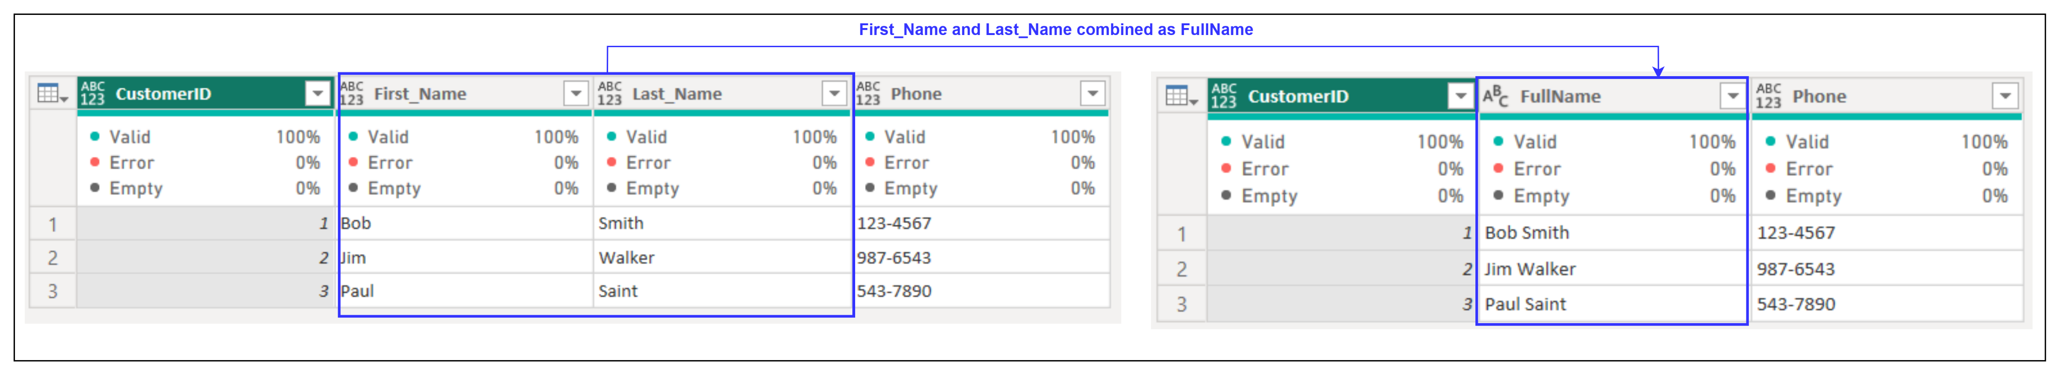
2. Table.CombineColumns
Description: Combines multiple columns into a single column using a delimiter.
Example:
Result:
Use Cases:
Concatenating first and last names.
Combining address fields into a single column.

Slide 4
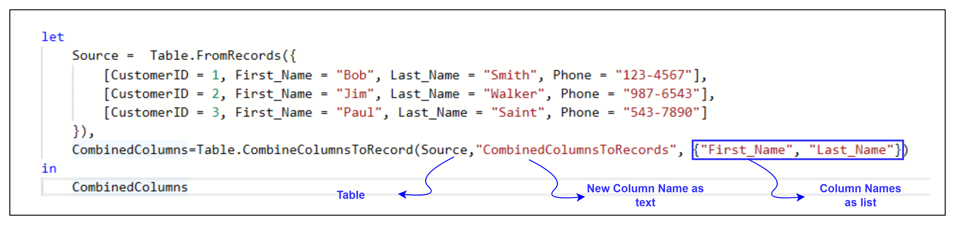
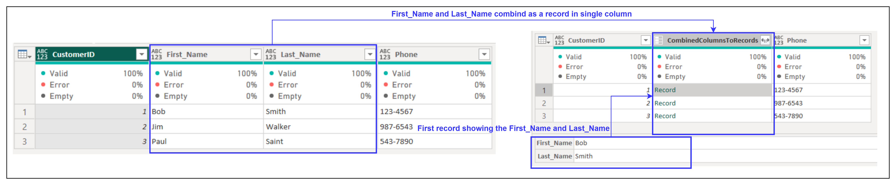
3. Table.CombineColumnsToRecord
Description: Combines the specified columns of table into a new record-valued column where each record has field names and values corresponding to the column names and values of the columns that were combined.
Example:
Result:
Use Cases:
Aggregating multiple columns into structured data (e.g., JSON-like records).
Preparing data for complex transformations or custom grouping.

Slide 5
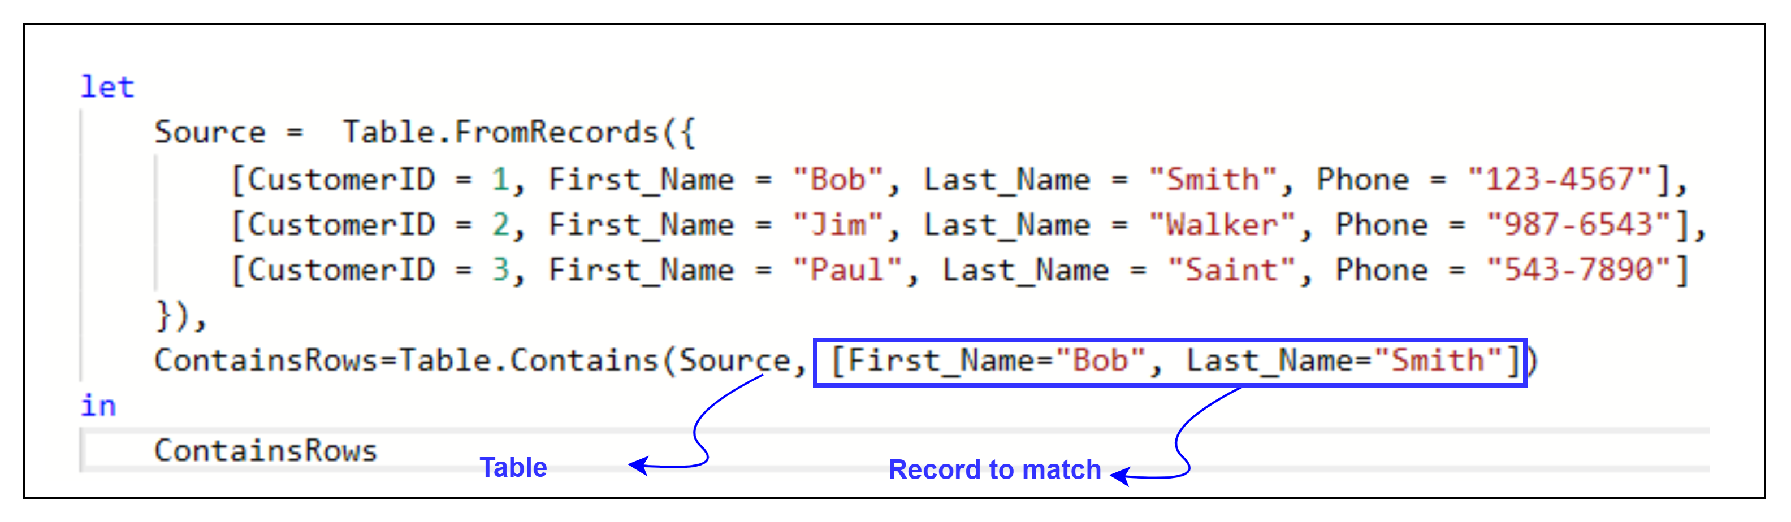
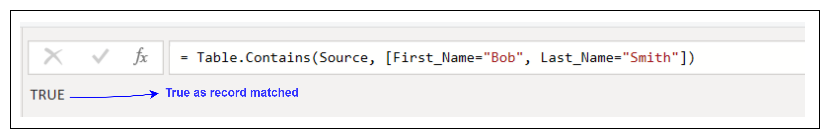
4. Table.Contains
Description: Indicates whether the specified record appears as a row in the table .
Example:
Result:
Use Cases:
Validating the existence of specific rows.
Filtering or decision-making based on row presence.

